Slide 1
Lecture 17: Software Architecture
“From design decisions to system blueprints”
Mia Mohammad Imran

Slide 2
Recap: Software Design
Software design bridges requirements and implementation.
Design transforms 'what' into 'how'.
Key concern: managing complexity early.

Slide 3
From Design to Architecture
Software Design: How each component works
Software Architecture: How all components fit together
Level | Focus | Example
Design | Algorithms, data structures | Login module, sorting function
Architecture | Structure, interaction | Web app with APIs and databases
“Design builds rooms; architecture builds the city.”

Slide 4
What Is Software Architecture?
The high-level structure of a software system, defining its components, relationships, and guiding principles.
Architecture addresses:
Organization of components
Communication and dependencies
Quality attributes (performance, scalability, modifiability)
Technology and infrastructure choices

Slide 5
Architectural vs Detailed Design
Aspect | Architectural Design | Detailed Design
Abstraction | High | Low
Concern | Components, interfaces | Algorithms, data structures
Scope | Entire system | Individual modules
Output | Architecture diagrams | UML class/sequence diagrams

Slide 6
Views and Viewpoints: 4+1 View Model (Kruchten)
Views are framed through viewpoints: perspectives of different stakeholders (e.g., user, developer, tester)
View | Focus | Example
Logical | Functional structure | Rider, Driver, Matching engine
Process | Concurrency, runtime behavior | Real-time tracking, pricing
Development | Code organization | Trip, Payment, Notification services
Physical | Deployment | Cloud servers, CDNs, containers
Use Case (+1) | End-user scenarios | “Book a ride,” “Watch a movie”

Slide 7
Example: Netflix
View | Description
Logical | Search, Recommendation, Playback modules
Process | Load balancing, concurrency, fault tolerance
Development | Microservices for each feature
Physical | AWS cloud + global CDN
Use Case | “Watch movie on mobile” supports streaming, caching, DRM
What happens when AWS cloud is down?

Slide 8
Common Architectural Styles
Layered
Client-Server
Microservices
Event-Driven
Service-Oriented (SOA)
Model-Based (MVC, MVP, MVVM)
Real-World Reflection: How did WhatsApp scale from 50M to 2B users?
Notes:
Real-World Reflection: How did WhatsApp scale from 50M to 2B users? Microservices and event-driven architecture were crucial.

Slide 9
Layered Architecture
Concept: Organized into hierarchical layers, each with specific responsibility.
Typical Layers:
Presentation → Business Logic → Data Access → Database
Advantages:
Clear separation of concerns
Easy maintenance and testing
Standardized flow
Limitations:
Slower performance due to multiple layers
Harder to skip layers when needed
Example: Traditional web or enterprise applications.

Slide 10
Client-Server Architecture
Concept: Two-tier communication model between requesters and providers.
Structure:
Client ↔ Server
Advantages:
Centralized control
Easier security management
Limitations:
Server bottleneck
Limited scalability
Examples:
Email systems, database servers, early web apps.

Slide 11
Microservices Architecture
Concept: System divided into independent, deployable services communicating via APIs.
Structure:
Service A | Service B | Service C
↕
API Gateway
Advantages:
Scalable and resilient
Independent deployment and maintenance
Enables different technologies per service
Limitations:
Complex communication management
Difficult to test end-to-end
Real Example: Netflix, Amazon, Uber.
https://aws.amazon.com/microservices

Slide 12
Event-Driven Architecture
Concept: Components communicate asynchronously through events.
Structure:
Publisher → Event Bus → Subscriber(s)
Advantages:
Loose coupling
High responsiveness
Scalable for distributed systems
Limitations:
Debugging complexity
Event tracing difficulty
Examples:
WhatsApp messaging, stock trading systems, IoT networks.

Slide 13
Service-Oriented Architecture (SOA)
Concept: System functions are exposed as reusable network services.
Structure:
Service Provider ↔ Service Registry ↔ Service Requester
Advantages:
Promotes reuse and integration
Works across heterogeneous systems
Limitations:
Performance overhead (SOAP/XML)
Complex governance
Examples:
Enterprise resource planning, e-government systems.
https://aws.amazon.com/what-is/service-oriented-architecture/

Slide 14

Model-View-Controller (MVC)
Concept: Separates user interface, logic, and data
Structure:
Model: Holds data and business logic
View: Displays data and receives user input
Controller: Handles user input, updates the model, and determines which view to render
Data Flow:
User → Controller → Model → View
User interacts with View
Controller processes input and updates Model
Model notifies View of changes
Examples: Django, Spring MVC, Ruby on Rails

Slide 15
Model-View-Controller (MVC)
Pros
Clear separation of concerns
Code reusability, as different Views can use the same Model and Controller
Supports parallel development, allowing UI designers and developers to work independently
Cons:
Tight coupling between View and Controller
Can become complex as the application grows

Slide 16
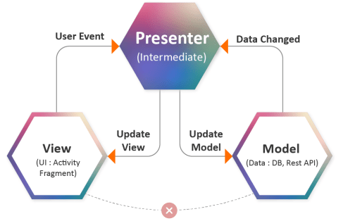
Model-View-Presenter
Concept: Presenter mediates between View and Model for UI testability
Flow:
View ↔ Presenter ↔ Model
Structure:
Model: Same as in MVC.
View: Interface or UI that delegates user input handling to the Presenter.
Presenter: Acts as an intermediary; retrieves data from Model and updates View.
Example: Android mobile apps, desktop GUIs.
Data Flow:
User interacts with View.
View delegates events to Presenter.
Presenter manipulates Model, updates View directly

Slide 17
Model-View-Presenter
Pros:
View is passive (no logic inside it)
Easier to test since Presenter can be unit tested without UI
Cons:
Presenter can become bloated if not managed properly
Tight binding between View and Presenter interfaces

Slide 18
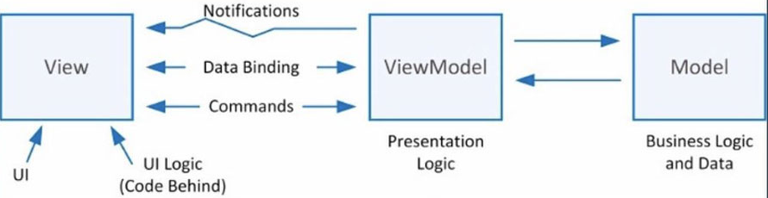
Model-View-ViewModel
Concept: ViewModel exposes observable data for automatic UI updates.
Flow:
User → View ↔ ViewModel ↔ Model
Structure:
Model: Same as MVC
View: UI layer bound to ViewModel properties
ViewModel: Exposes data and commands for the View, handling presentation logic
Data Flow:
View and ViewModel communicate via data binding
Changes in Model automatically reflect in View and vice versa
Examples: Angular, React, SwiftUI, Jetpack Compose (Android).

Slide 19
Model-View-ViewModel
Pros:
Minimizes glue code with data binding
High testability of logic (ViewModel independent of UI framework)
Promotes reactive programming
Cons:
Data binding can introduce hidden performance or debugging issues
Overkill for small applications

Slide 20
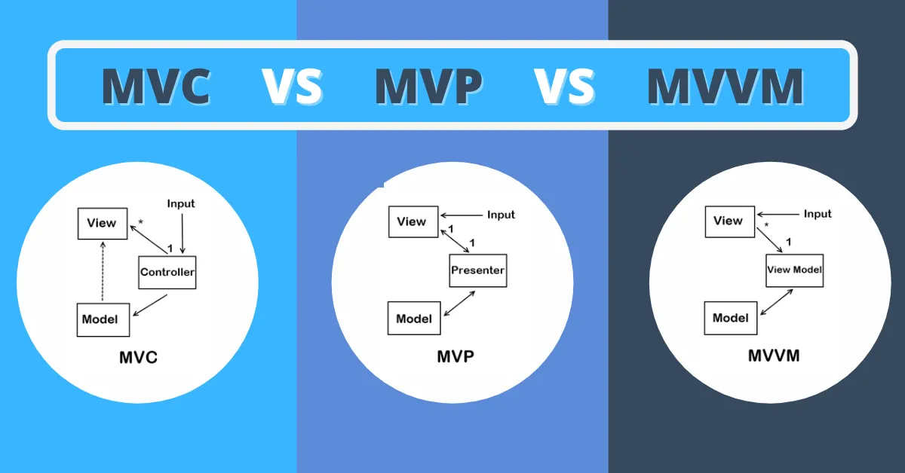
What is the difference?

Slide 21
EventBus Pattern
More of a Software Design Pattern than a Architecture (can be in-between, depends)
Concept: Enables asynchronous communication between components via a centralized bus.
Flow:
Publisher → EventBus → Subscriber(s)
Advantages:
Decoupled communication
Ideal for event-driven systems
Limitations:
Difficult debugging and lifecycle management
Examples: Android EventBus, RabbitMQ, Kafka.

Slide 22
Summary
Architecture | Core Idea | Data Binding | Use Case | Example
MVC | Controller coordinates model & view | Manual | Web apps | Django
MVP | Presenter handles logic | Manual | Mobile apps | Android
MVVM | ViewModel exposes reactive data | Automatic | Reactive UI | React, Angular
EventBus | Event-driven async messaging | N/A | Background events | Kafka, EventBus

Slide 23
System Design Interview!
Amazon System Design Interview (questions, process, prep) - IGotAnOffer https://share.google/dMoX3W9NTleqVwZJW
Amazon System Design Interview Questions - GeeksforGeeks https://share.google/pyANc3WfRtnFLjPAR
45 system design questions I curated for interviews : r/leetcode https://share.google/GznZHFfGH2QuuuljC
Cracking Amazon System Design Interview: Top Questions and Answer - DEV Community https://share.google/d995U6VCwgmuKyBcL

Slide 24
Let’s Build a Pet/Baby Monitor Android Application
What are the functionalities?

Slide 25
Let’s Build a Pet/Baby Monitor Android Application
What are the functionalities?
Live Video Streaming
Audio Monitoring and Talkback
Motion and Sound Alerts
Night Mode / Infrared Integration
Recording and Playback
Multi-device Support

Slide 26
Let’s Build a Pet/Baby Monitor Android Application
Non-functional Requirements
Attribute | Requirement
Performance | Real-time streaming (<300 ms latency)
Scalability | Support multiple concurrent video streams
Reliability | Automatic reconnection if connection drops
Security | End-to-end encryption (TLS + authentication)
Maintainability | Modular micro-feature architecture
Usability | Simple, intuitive interface (declarative UI)

Slide 27
Let’s do Architecture
What’s the Architecture here?

Slide 28
Let’s do Architecture
What’s the Architecture here?
MVVM enables clean UI-state separation
Event-driven messaging supports push alerts and asynchronous updates
Cloud microservices enable scalable backend processing (e.g., storage)

Slide 29
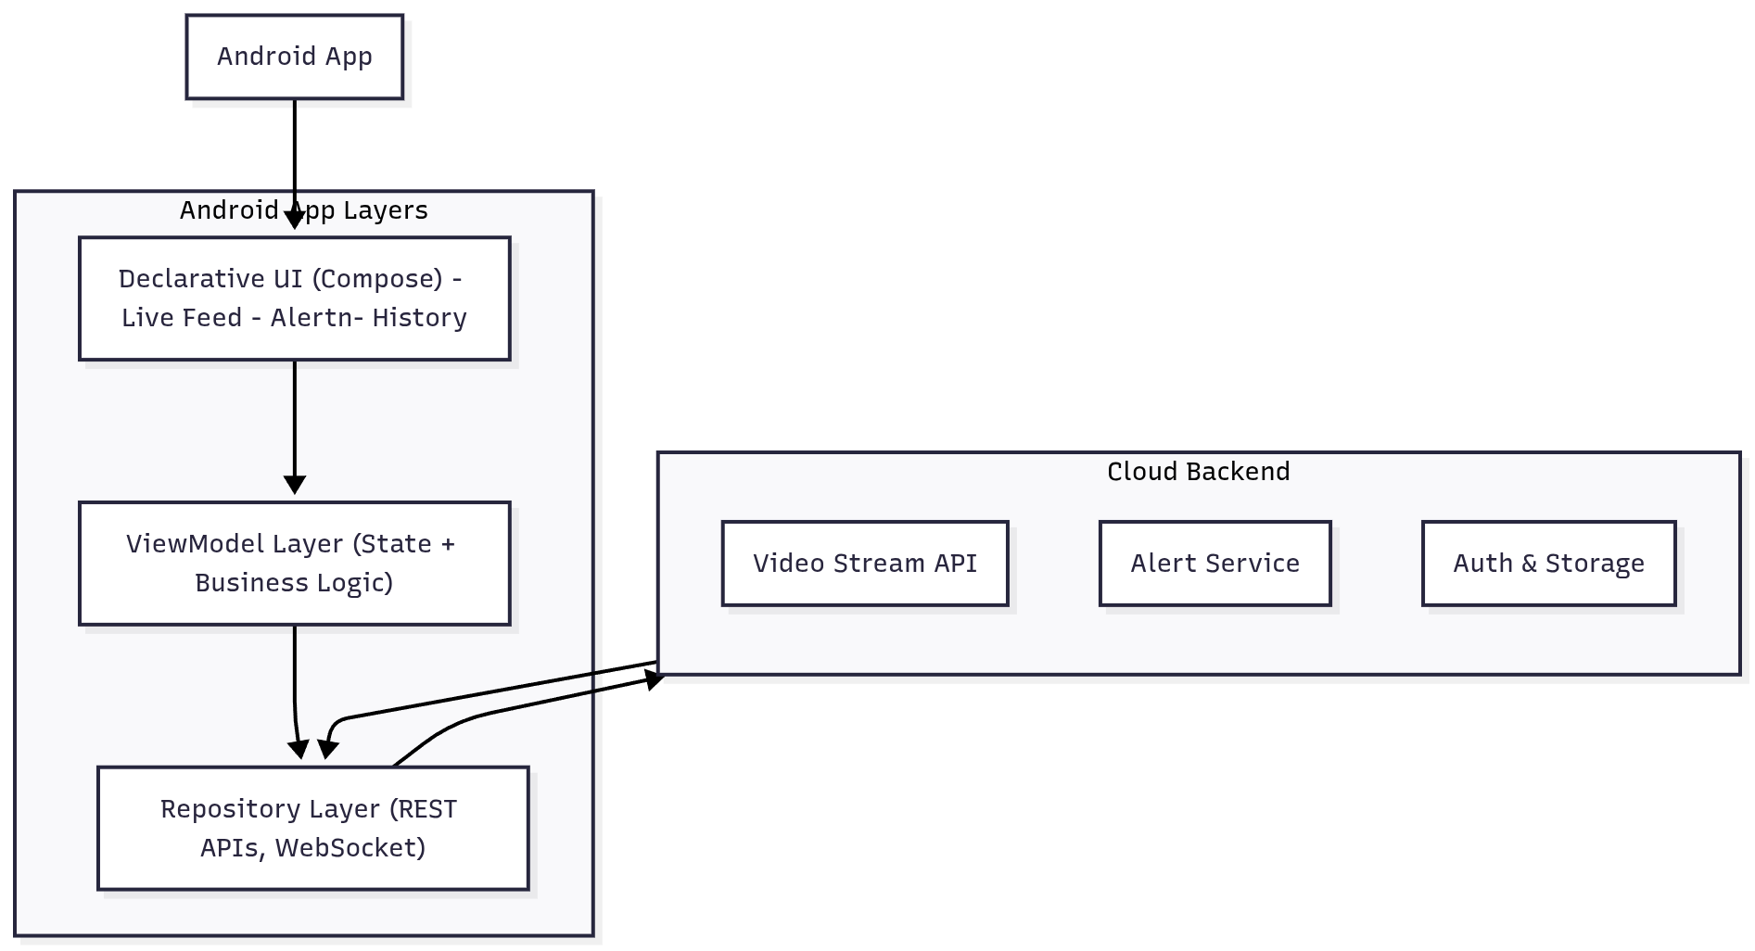
High-Level Architecture Diagram

Slide 30
Layered Architecture
Layer | Components | Responsibility
UI Layer | Jetpack Compose | Displays live stream, alerts, and control actions
Presentation Layer | ViewModel | Holds state, communicates with repository, observes camera feed
Data Layer | Repository, Retrofit, WebSocket | Manages API calls, WebSocket connections, local cache
Backend Services | Firebase / AWS / Custom | Handles authentication, stream relay, push notifications, storage

Slide 31
Data Flow
Unidirectional Flow (MVVM + EventBus pattern)
Camera device publishes events (motion, sound, video frames)
Cloud service routes data via WebSocket and Notification APIs
Repository subscribes to events and updates the ViewModel state
Compose UI re-renders automatically based on updated state
Camera detects motion →
EventBus publishes event →
Backend sends Firebase notification →
Repository receives alert →
ViewModel updates UI →
User notified instantly

Slide 32
Key Components
UI Layer
LiveFeedScreen: Displays video stream and controls (mute, talkback)
AlertScreen: Lists motion/sound alerts chronologically
SettingsScreen: Camera pairing, sensitivity, and alert preferences
@Composable
fun LiveFeedScreen(viewModel: MonitorViewModel) {
val uiState = viewModel.uiState
VideoStream(url = uiState.streamUrl)
if (uiState.alertActive) AlertBanner(message = uiState.alertMessage)
}

Slide 33
Key Components
ViewModel Layer
Maintains observable UI state (StateFlow / LiveData)
Interacts with repository
Handles reconnection logic and state persistence
class MonitorViewModel(private val repository: MonitorRepository) : ViewModel() {
val uiState = repository.streamState.stateIn(viewModelScope, SharingStarted.Eagerly, defaultState)
fun reconnect() = repository.reconnectStream()
}

Slide 34
Key Components
Repository Layer
Uses Retrofit for RESTful APIs
WebSocket for real-time streaming
Integrates Room Database for offline caching

Slide 35
Backend Services
Service | Function
Video Service | Real-time video relay using WebRTC or RTSP
Notification Service | Sends Firebase Cloud Messaging alerts
Auth Service | Secure device pairing (JWT / OAuth2)
Storage Service | Video and metadata storage in cloud
AI Detection Service (a new service) | Identifies abnormal patterns (crying, barking)

Slide 36
Event Handling
Ensures decoupled communication between app modules.
Example events:
MotionDetectedEvent
SoundDetectedEvent
StreamDisconnectedEvent
Implementation: Using Kotlin coroutines + SharedFlow or a lightweight EventBus library.

Slide 37
Security Architecture
Encrypted video stream (TLS/SSL)
Authentication: Firebase Auth or OAuth2 tokens
Encrypted cloud storage for media files
Role-based access (e.g., Parent, Guest Viewer)

Slide 38
Example System Deployment
Mobile App → API Gateway → Cloud Services → IoT Camera
↘ Push Notifications (Firebase)
WebRTC for low-latency video
  real-time communication protocol enabling peer-to-peer audio, video, and data transfer directly between browsers or devices
MQTT or WebSocket for event streaming
  WebSocket: A full-duplex communication protocol that provides persistent, bidirectional connections between a client and a server over a single TCP connection → WhatsApp use WebSocket on Desktop/Web
  MQTT: A lightweight publish-subscribe messaging protocol designed for low-bandwidth, high-latency, or unreliable networks, commonly used in IoT → WhatsApp use MQTT on Mobile devices
Firebase Cloud Messaging (FCM) for alert delivery

Slide 39
Summary
Architecture: MVVM + Event-driven communication
UI Framework: Jetpack Compose
Backend: Microservices
Patterns Used: Repository, EventBus, Observer
Focus: Scalability, security, low latency, and modularity
Attribute | Design Decision
Scalability | Stateless microservices + load balancer
Resilience | Retry/reconnect strategy in ViewModel
Security | Auth tokens + encrypted transport
Maintainability | MVVM separation + modular code
Performance | Real-time WebRTC + background streaming threads

